Slide 1
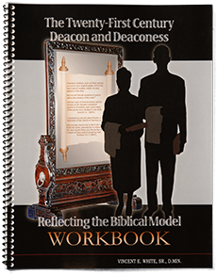
Presentation prepared by AVA’s Book Publishers
Elder Vincent E. White, Sr., D.Min.
Copyright © 2013

Slide 2
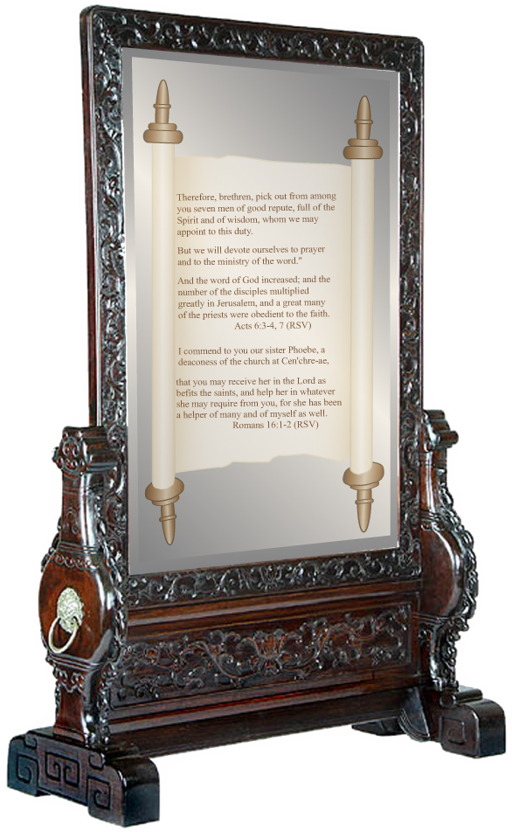
CHAPTER 2
THE ROLE OF DEACONS IN THE FIRST CENTURY CHRISTIAN CHURCH
The impact made by the seven deacons was “…the word of God increased; and the number of the disciples multiplied in Jerusalem greatly; and a great company of the priests were obedient to the faith.” Acts 6:7
Mirror Image by Stanley Weiss
Collection, www.stanleyweiss.com

Slide 3
Some of the issues behind the allegations made against the Hebrews by the Grecians were old prejudices of the past resurfaced. Feelings of distrust, jealousy, and suspicion brought about faultfinding and murmuring. Allegations were made that the Grecian widows were being neglected in the “daily ministration.” Acts 6:1
Mirror Image by Stanley Weiss
Collection, www.stanleyweiss.com

Slide 4
“The enemy [Satan] succeeded in arousing the suspicions of some who had formerly been in the habit of looking with jealousy on their brethren in the faith and of finding fault with their spiritual leaders.”
AA 88
Mirror Image by Stanley Weiss
Collection, www.stanleyweiss.com

Slide 5
Satan had launched a spiritual attack against the church in an attempt to hinder it from growing and ultimately to destroy it.
Mirror Image by Stanley Weiss
Collection, www.stanleyweiss.com

Slide 6
The Greek word for deacon “diakonos literally means ‘through dust.’ Although the origin of the word is questioned, the concept of raising dust suggests a servant hastening to serve or to wait on his master.”
Catoe, “Equipping Deacons for Ministry” (D.Min. dissertation, Drew Univ., 1989), 13
Mirror Image by Stanley Weiss
Collection, www.stanleyweiss.com

Slide 7
“…The root idea [of deacon] is one who reaches out with diligence and persistence to render a service on behalf of others. This would imply that the deacon reaches out to render love-prompted service to others energetically and persistently.”
Hiebert, p. 153
Mirror Image by Stanley Weiss
Collection, www.stanleyweiss.com

Slide 8
Therefore, as we trace the roots of the office of deacons, we discover that the reason that they came into existence was to serve and to share the responsibilities of the work. They came into existence because of a problem. Therefore, the primary function of the first century deacons was to solve problems that arose in the church.
Mirror Image by Stanley Weiss
Collection, www.stanleyweiss.com

Slide 9
The spiritual qualities required of the deacons of the first century Christian church strongly imply that their calling was a spiritual calling, and their responsibilities were far greater than just waiting on tables. They were men of “honest report, full of the Holy Ghost and wisdom.”
Acts 6:3
Mirror Image by Stanley Weiss
Collection, www.stanleyweiss.com

Slide 10
“It must be pointed out that the seven men chosen for the special tasks of caring for the widows and serving tables were not specifically called deacons in Acts 6. First, and foremost, they were called to perform a service. When the term “deacon” is used subsequently in the New Testament, it is generally assumed that it refers to men
Mirror Image by Stanley Weiss
Collection, www.stanleyweiss.com

Slide 11
who were performing service similar to that which was assigned to the original seven who were selected. This assumption seems logical when it is understood that the Greek word from which ‘deacon’ is derived usually describes the work of a servant. Whether or not there was a difference between the tasks described in the Book of Acts and that which might be
Mirror Image by Stanley Weiss
Collection, www.stanleyweiss.com

Slide 12
called the office of deacon in the church seems today to be inconsequential. The fact is that these people performed the work of serving; therefore they may be called deacons, or those who serve.”
Nichols, The Work of the Deacon
and Deaconess, p. 1-2
Mirror Image by Stanley Weiss
Collection, www.stanleyweiss.com

Slide 13
THE END
QUESTIONS AND ANSWERS
Mirror Image by Stanley Weiss
Collection, www.stanleyweiss.com

Slide 14
Mirror Image by Stanley Weiss
Collection, www.stanleyweiss.com

