Slide 1
Presentation prepared by AVA’s Book Publishers
Elder Vincent E. White, Sr., D.Min.
Copyright © 2013

Slide 2
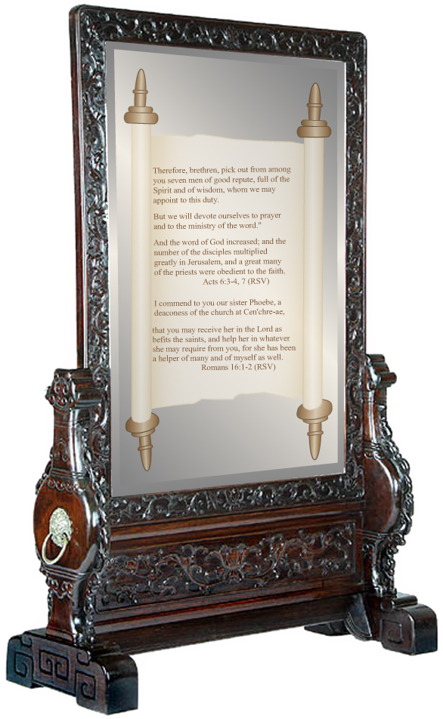
PART I
TOWARD A THEOLOGY OF MINISTRY FOR DEACONS AND DEACONESSES
Mirror Image by Stanley Weiss
Collection, www.stanleyweiss.com

Slide 3
CHAPTER 1
JESUS’ MODEL OF SERVANT MINISTRY
God, through the prophet, referred to Jesus as “my righteous servant [who will] justify many; for he shall bear their iniquity.”
Isa. 53:11
Mirror Image by Stanley Weiss
Collection, www.stanleyweiss.com

Slide 4
Most of Jesus’ ministry was devoted to nurturing and training His disciples and healing the sick.
“During His ministry, Jesus devoted more time to healing the sick than to preaching. His miracles testified to the truth of His words, that He came not to destroy, but to save.” MH 19
Mirror Image by Stanley Weiss
Collection, www.stanleyweiss.com

Slide 5
As Jesus went about healing the afflicted and preaching the gospel, He took His disciples along with Him. This was His method of training them for their future work of ministry.
Mirror Image by Stanley Weiss
Collection, www.stanleyweiss.com

Slide 6
“And into whatsoever city ye enter…heal the sick that are therein, and say unto them, The kingdom of God is come nigh unto you. …And the seventy returned again with joy, saying, Lord, even the devils are subject unto us. …Notwithstanding in this rejoice not, that the spirits are subject unto you; but rather rejoice, because your names are written in heaven.”
Luke 10:8, 9, 17, 20
Mirror Image by Stanley Weiss
Collection, www.stanleyweiss.com

Slide 7
The important lesson that Jesus wanted His disciples to learn from His statement in Luke 10:20 was regarding the self-destructive danger that comes with the love for power.
Mirror Image by Stanley Weiss
Collection, www.stanleyweiss.com

Slide 8
“Rejoice not in the possession of power, lest you lose sight of your dependence upon God. Be careful lest self-sufficiency come in, and you work in your own strength, rather than in the spirit and strength of your Master. Self is ever ready to take the credit if any measure of success attends the work.”
DA 493
Mirror Image by Stanley Weiss
Collection, www.stanleyweiss.com

Slide 9
Ministry is not about power, control, and greatness as viewed by worldly standards, but it is about service to God and humanity.
“…Whosoever will be great among you, let him be your minister; And whosoever will be chief among you, let him be your servant:
Mirror Image by Stanley Weiss
Collection, www.stanleyweiss.com

Slide 10
Even as the Son of man came not to be ministered unto, but to minister, and to give his life a ransom for many.”
Matt 20:26-28
Jesus indicated that His life’s mission was to serve others rather than being served Himself. This was His model for ministry.
Mirror Image by Stanley Weiss
Collection, www.stanleyweiss.com

Slide 11
The Greek word for deacon (διάκονος) means “one who renders service to another; an attendant, servant.”
Moulton, ed., The Analytical
Greek Lexicon
Mirror Image by Stanley Weiss
Collection, www.stanleyweiss.com

Slide 12
“All Jesus’ followers were to serve by providing ministry in his name. The title diakonos (servant) applied to every Christian, but the apostle Paul also used it in a special sense for specific church leaders (Phil. 1:1; 1 Tim. 3).”
Webb, Deacons: Servant Models
in the Church, p. 12
Mirror Image by Stanley Weiss
Collection, www.stanleyweiss.com

Slide 13
“In His earthly ministry Jesus Himself was the ‘Deacon’ par excellence. He set the example not only for deacons but for all believers.”
Hiebert, “Behind the Word Deacon,” Bibliotheca Sacra 140 (Apr.-
Jun 1983) p. 160
Mirror Image by Stanley Weiss
Collection, www.stanleyweiss.com

Slide 14
Jesus’ ministry as a servant provides the theological foundation for the ministry of deacon and deaconess. As deacons and deaconesses follow Jesus’ example, they are to enlist the members of the church into a life of service.
Mirror Image by Stanley Weiss
Collection, www.stanleyweiss.com

Slide 15
THE END
QUESTIONS AND ANSWERS
Mirror Image by Stanley Weiss
Collection, www.stanleyweiss.com

Slide 16
Mirror Image by Stanley Weiss
Collection, www.stanleyweiss.com

