Slide 1
Presentation prepared by AVA’s Book Publishers
Elder Vincent E. White, Sr., D.Min.
Copyright © 2013

Slide 2
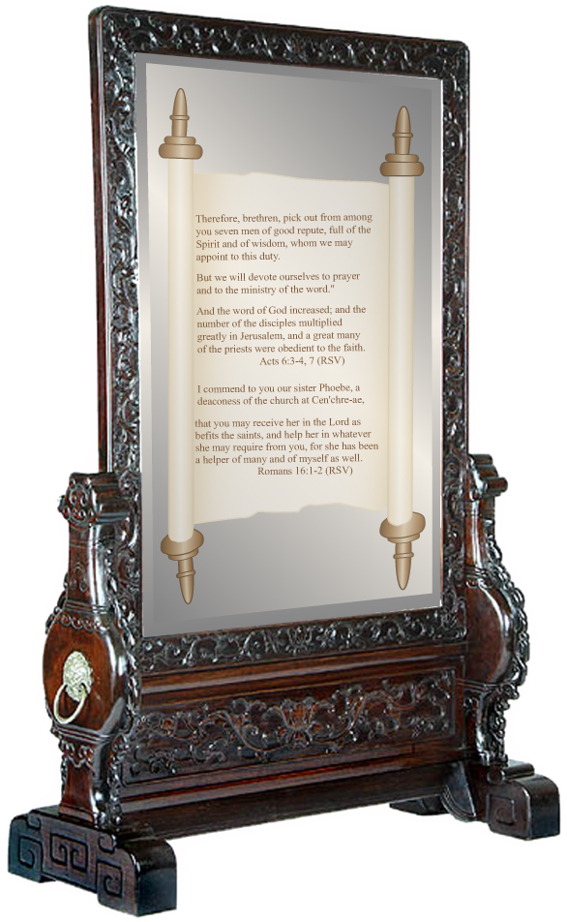
THE AGREEMENT
I AGREE THAT I WILL NOT COPY, REPRODUCE, OR DISTRIBUTE THE CONTENTS OF THIS CD, IN WHOLE OR IN PART, UNLESS I HAVE WRITTEN PERMISSION FROM THE COPYRIGHT OWNER. TO DO SO IS UNLAWFUL.
IF YOU AGREE, YOU MAY PROCEED TO USE THIS CD.
Mirror Image by Stanley Weiss
Collection, www.stanleyweiss.com

